Slide 1
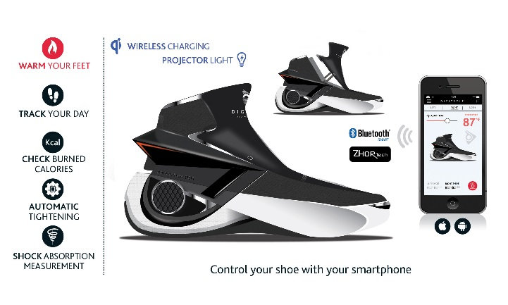
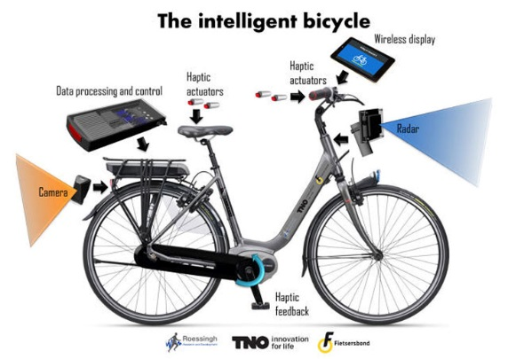
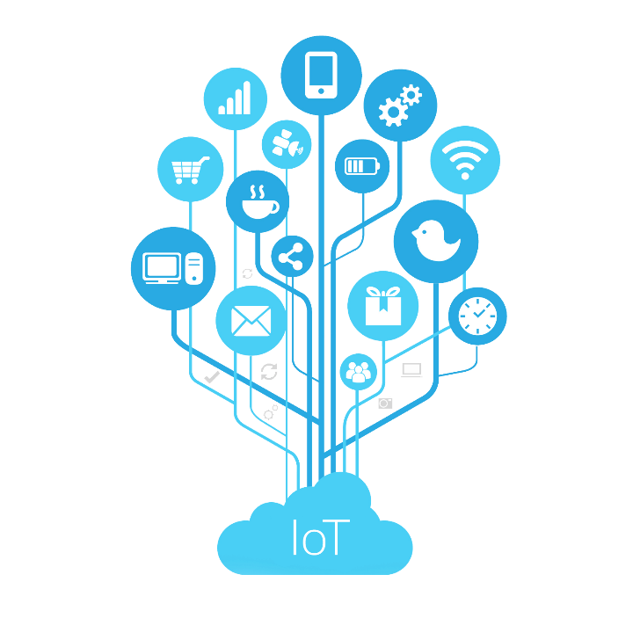
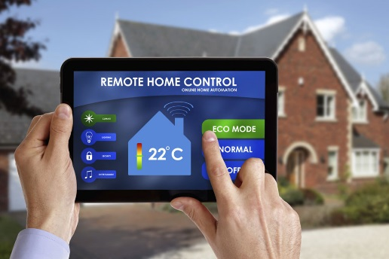
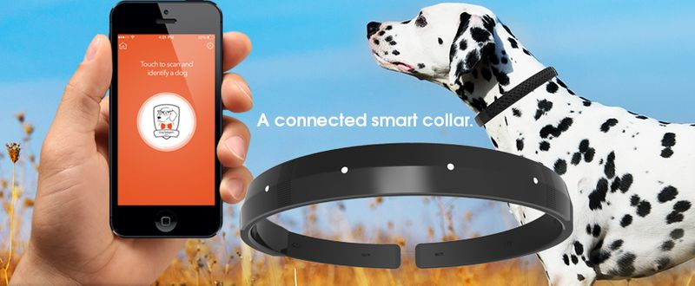
Disruption: Internet of Things
Making “dumb” devices “smart”
embed with sensors, software, network connectivity to enable collection and exchanging of data
Integration of physical world into virtual world
Smart shoes
Smart bike
Smart home
Smart pets

Slide 2
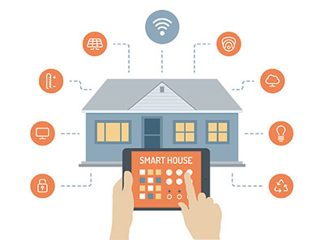
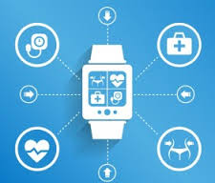
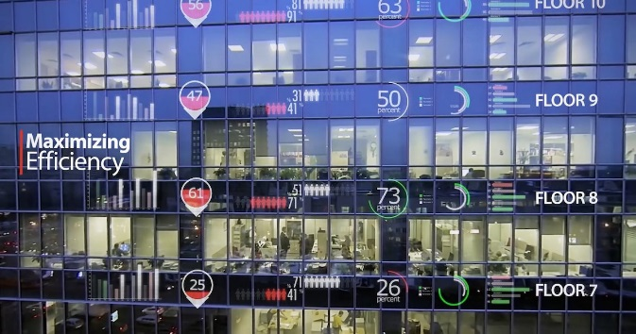
IoT: Industries
Home automation
e.g.: Smart light bulbs
Healthcare
e.g.: Fitbit activity trackers
Facilities management
e.g.: Sensing temperature, humidity of environment

Slide 3
IoT: Benefits
Receiving real-time information
Data analytics
Save time and resources by automation

